Slide 1
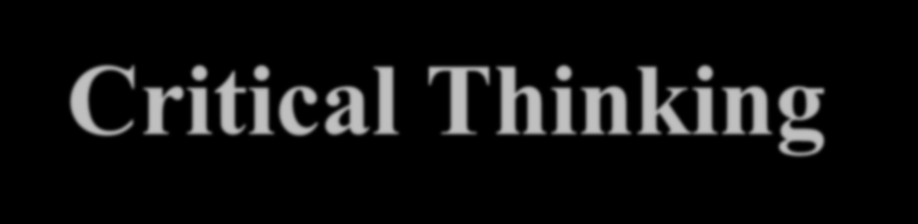
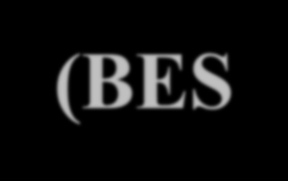

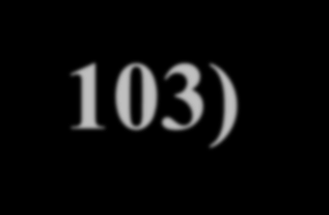
Critical Thinking (BES-103)
Lecture 3
Critical Thinking Barrier
Hadiqua Fazal
Assistant Professor
Computer Science Department

Slide 2
Lecture Outline
▷ Egocentrism
▷ Sociocentrism
▷ Unwarranted Assumptions
▷ Relativistic Thinking
▷ Wishful Thinking

Slide 3
Egocentrism
▷ Egocentrism is the tendency to see reality as centered on oneself.
▷ Egocentrics are selfish, self-absorbed people who view their interests, ideas, and values as superior
to everyone else’s.
▷ Egocentrism can manifest itself in a variety of
ways. Two common forms are:
▷ self-interested thinking
▷ self-serving bias

Slide 4
Egocentrism-Self-Interested Thinking
▷ Self-interested thinking is the tendency to accept and defend beliefs that harmonize with one’s self-interest.
▷ Self-interest is defined as being focused on yourself or putting yourself at an advantage. An example of self-interest is thinking about your needs above the needs of others around you.

Slide 5
Example
▷ You are on a committee to decide if classes should start at 8am and finish at 3pm or start at 9am and finish at 4pm.
▷ You do a survey and find that many people want to finish early (they travel long distances).
▷ BUT, you vote to start later because you want to sleep in.

Slide 6
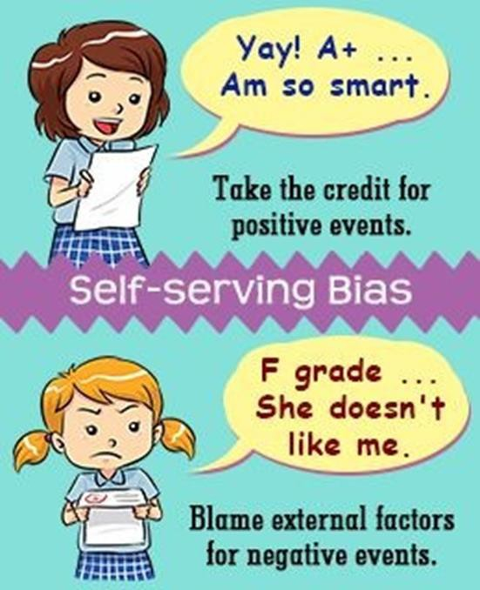
Self-Serving Bias
A self-serving bias is the common habit of a person taking credit for positive events or outcomes but blaming outside factors for negative events.
This can be affected by age, culture, clinical diagnosis, and more.
It tends to occur widely across
populations.

Slide 7
Example
▷ A student gets a good grade on a test and tells herself that she studied hard or is good at the material. She gets a bad grade on another test and says the teacher doesn’t like her or the test was unfair.

Slide 8
Sociocentrism
▷ Sociocentrism is group-centered thinking. Just as egocentrism can hinder rational thinking by focusing excessively on the self, so sociocentrism can hinder rational thinking by focusing excessively on the group.
▷ Two of the most important are group bias and conformism.

Slide 9
Group Bias
▷ Group bias is the tendency to see one’s own group (nation, tribe, sect, peer group, and the like) as being inherently better than others.
▷ Social scientists tell us that such thinking is extremely
common throughout human history and across cultures. Just as we seem naturally inclined to hold inflated views of ourselves, so we find it easy to hold inflated views of our family, our community, or our
nation.
“Karachi Biryani is the best in the world”

Slide 10
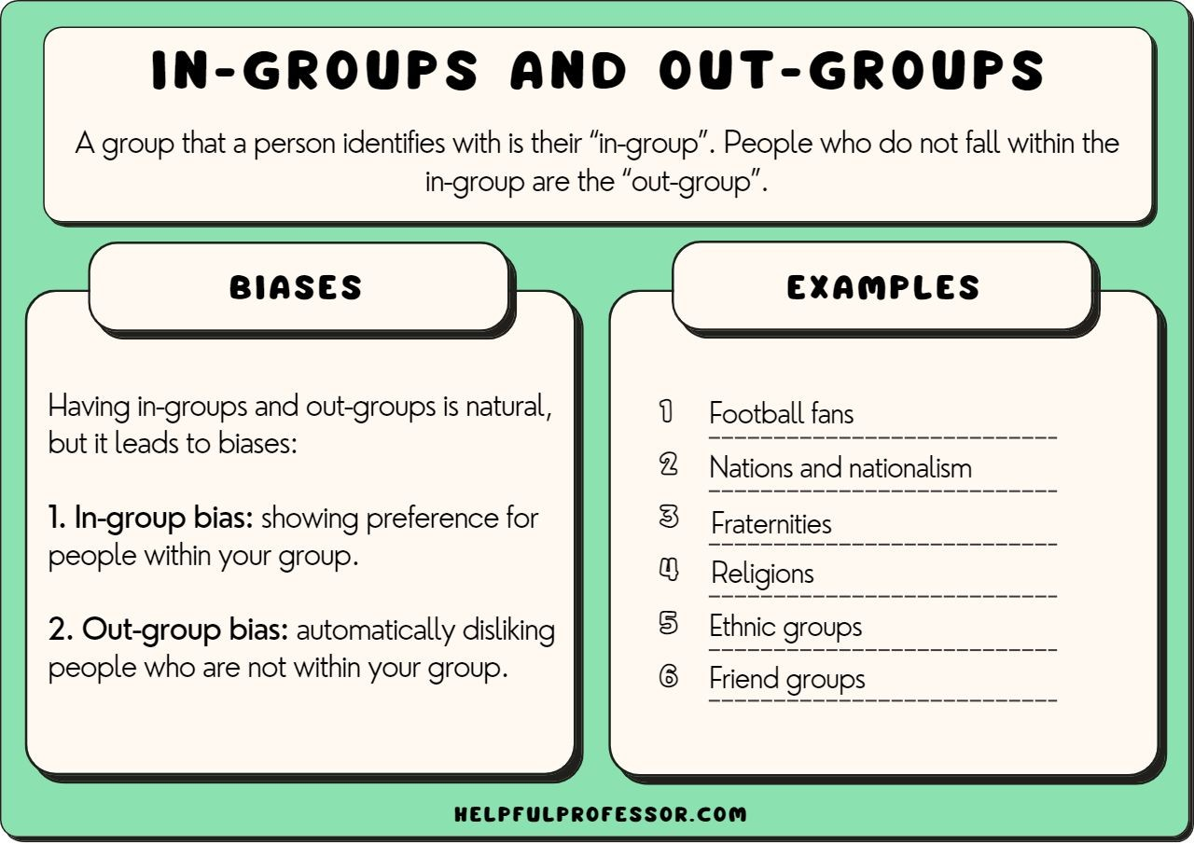

Slide 11
Conformism
▷ Conformism refers to our tendency to follow the crowd—that is, to conform (often unthinkingly) to authority or to group standards of conduct and belief. The desire to belong, to be part of the in-group, can be among the most powerful of human motivations.
▷ The desire to conform can seriously cripple our powers of critical reasoning and decision- making.

Slide 12
Relativistic Thinking
▷ Relativism is the view that truth is a matter of opinion.
▷ There are relativism: relativism.
two popular forms of
subjectivism and cultural

Slide 13
Relativistic Thinking-Subjectivism
Subjectivism is the view that truth is a matter of individual opinion.
It is because each person has different beliefs and perceptions about knowledge and morality. So, what is right or wrong for one person may not be right or wrong for another.
“Hanging the criminal is right”
This is what I think.

Slide 14
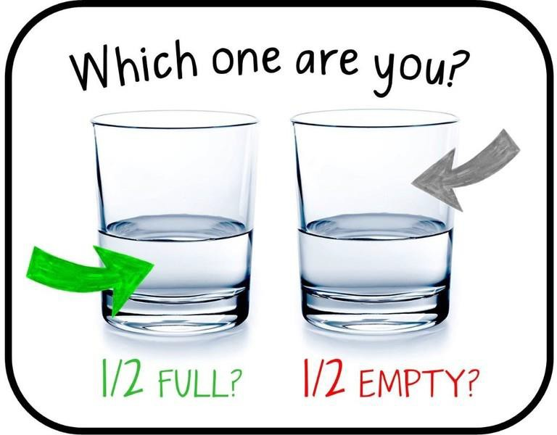
Relativistic Thinking-Subjectivism

Slide 15
Relativistic Thinking-Cultural Relativism
This is the view that truth is a matter of social or cultural opinion.
In other words, cultural relativism is the view that what is true for person A is what person A’s culture or society believes is true. Drinking wine, for example, is widely considered to be wrong in Iran but is not generally considered to be wrong in France. According to cultural relativism, therefore, drinking wine is immoral in Iran but is morally permissible in France.

Slide 16
Unwarranted Assumptions
Unwarranted assumptions are claims or beliefs that possess little to no supporting evidence, things we might take for granted as true, or just completely false ideas we inherited without reflection.
Prejudices and stereotypes are some common ways in which we make unwarranted assumptions.
For example, all Irish are alcoholic bar‐fighting people; the only food in America is McDonald's; or all Canadians drink maple syrup instead of water.

Slide 17
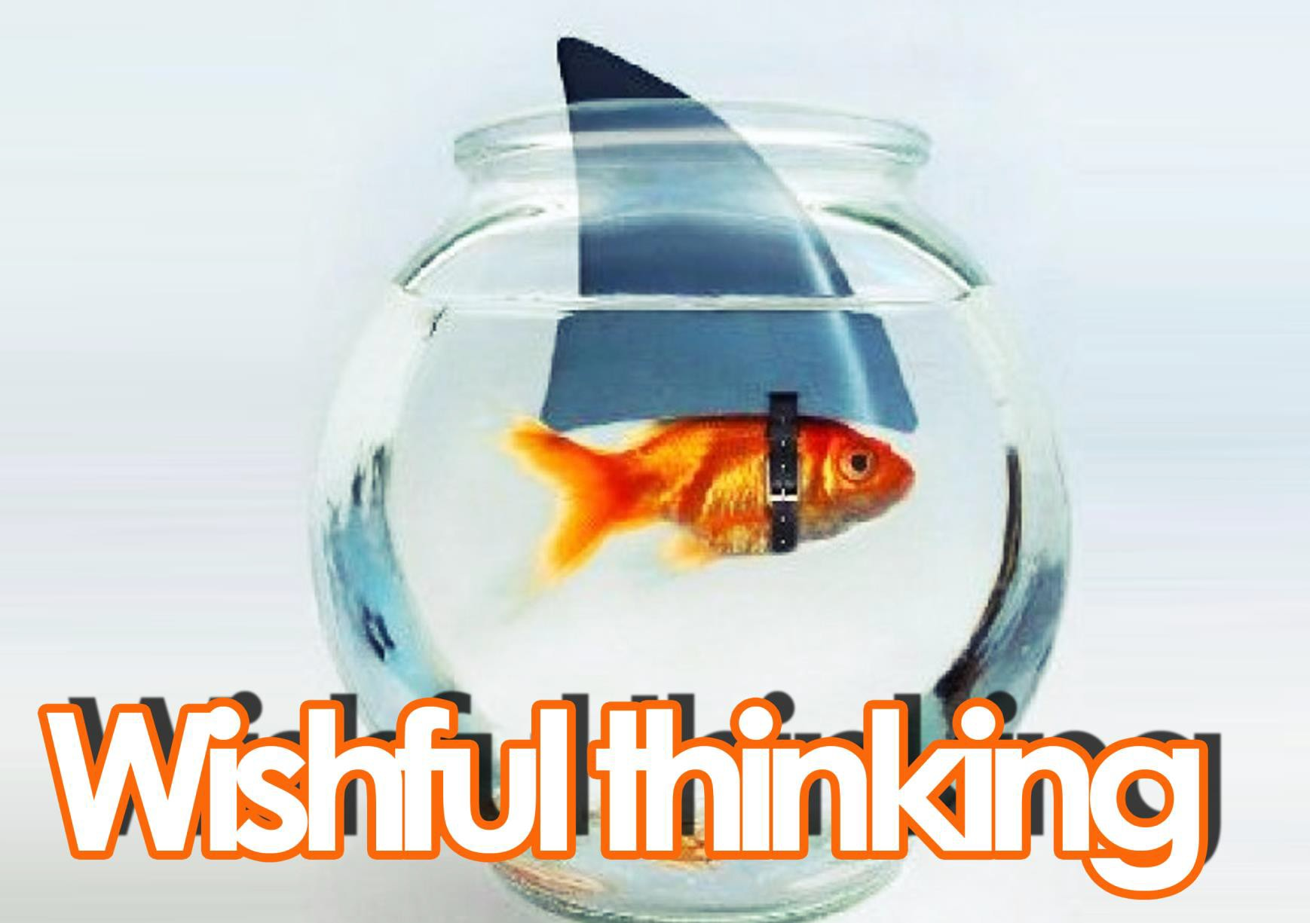

Slide 18
Wishful Thinking
Wishful thinking is the formation of beliefs based on what might be pleasing to imagine, rather than on evidence, rationality, or reality.
Example
There must be life on other planets. Imagine how lonely we’ll find the universe if we discover we are the only ones here.

